Slide 1
Affiliate League Twitter Scraping Model
Team name: RJWithoutTheJ
Team members: Julia Wapner, Aaron Angeles, Frank Hu,
Noah Jankowski, Caroline Singer,
Sanjit Thavarthy, Evelyn Sun, Luke Thomas

Slide 2
Data Collection and Preparation
Accounts
WNBA Teams Twitters
G League Teams Twitters
2K League Teams Twitters
NBA League Twitter
Collected Data
Tweets from 1/1/2021-11/1/2021
Start time data for all games played this year
Preprocessing
Convert tweet times to local time for each team
Classify tweets as in-game or out-of-game
1 hour before start times
4 hours after G League start times
3 hours after WNBA start times
2 hours after 2K start times

Slide 3
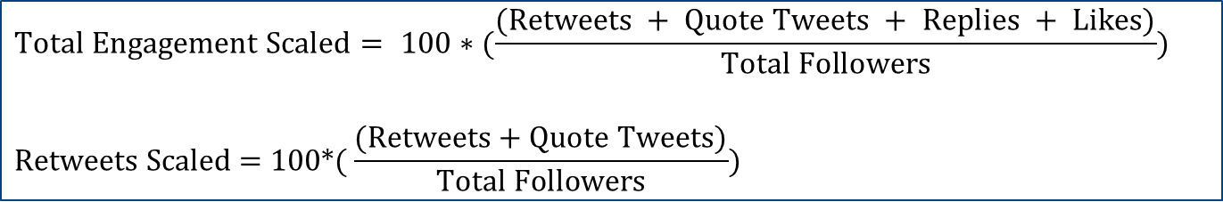
Current Affiliate League Twitter Stats
League | Average in-game engagement | Average out-of-game engagement | Average in-game retweets | Average out-of-game retweets
WNBA | 0.267 | 0.363 | 0.035 | 0.041
G-League | 0.330 | 0.477 | 0.045 | 0.061
2k League | 0.167 | 0.065 | 0.010 | 0.029

Slide 4
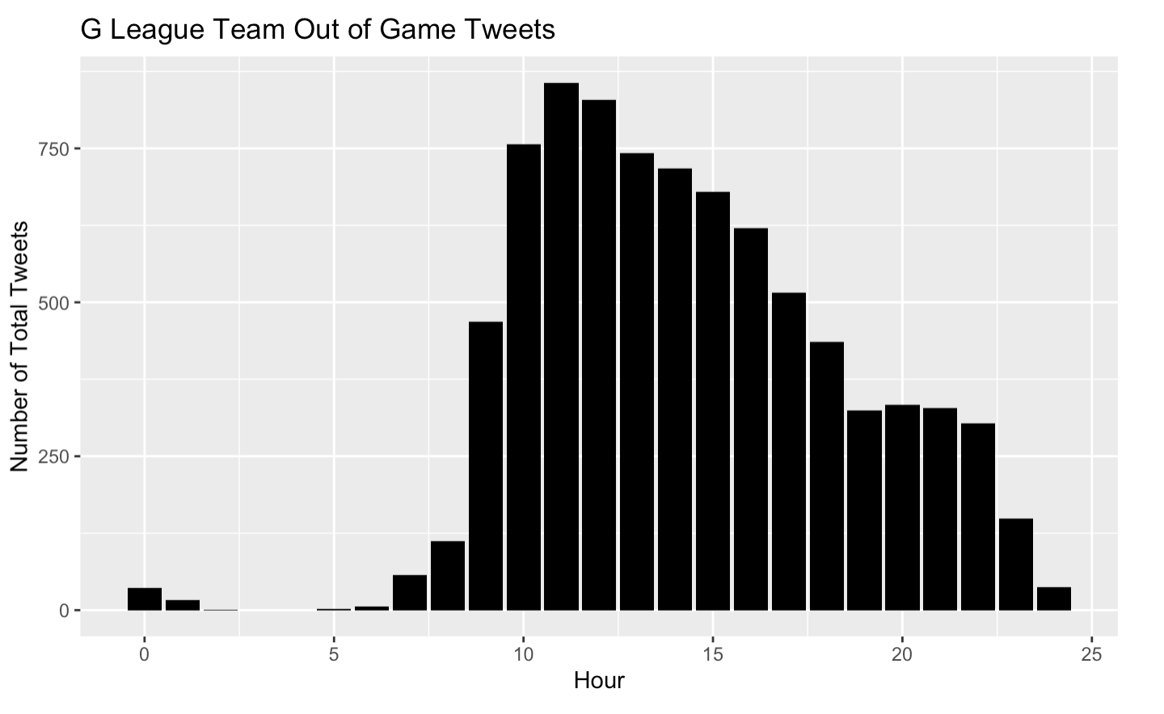
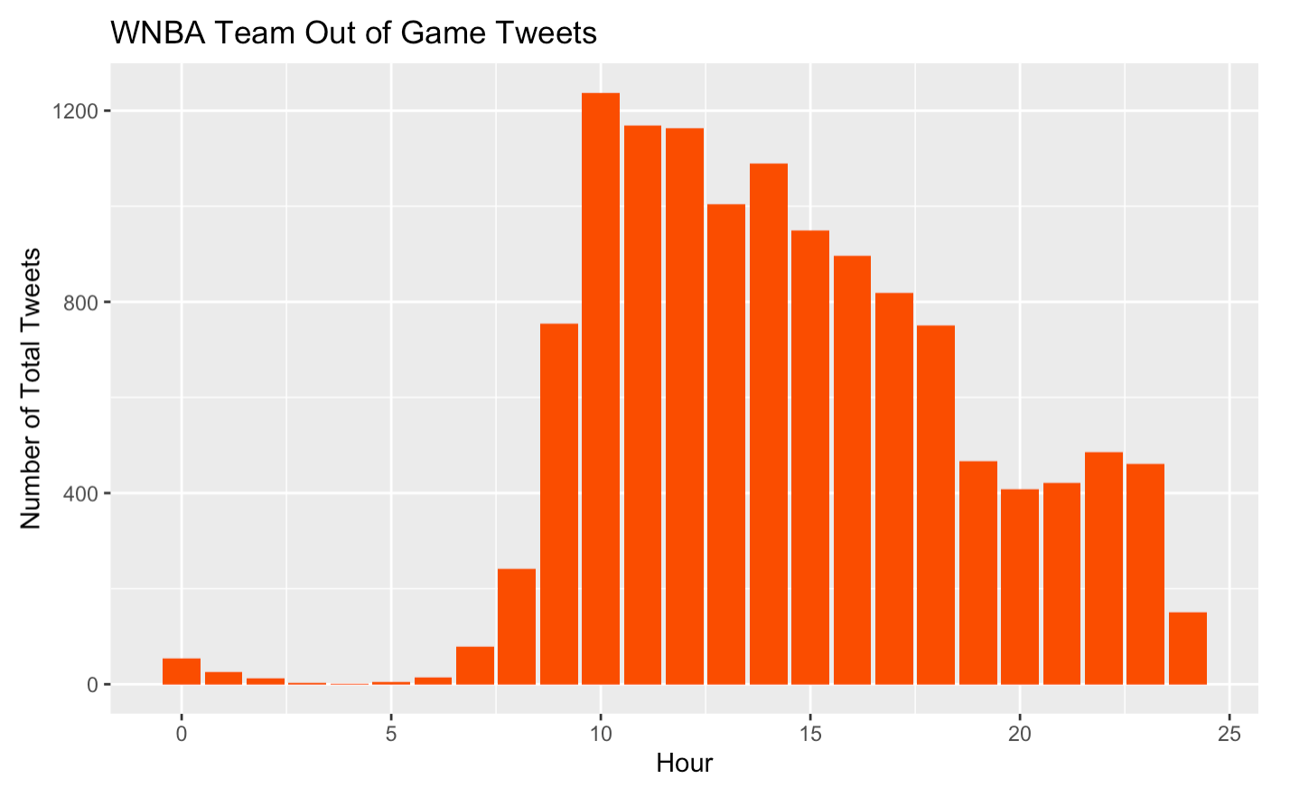
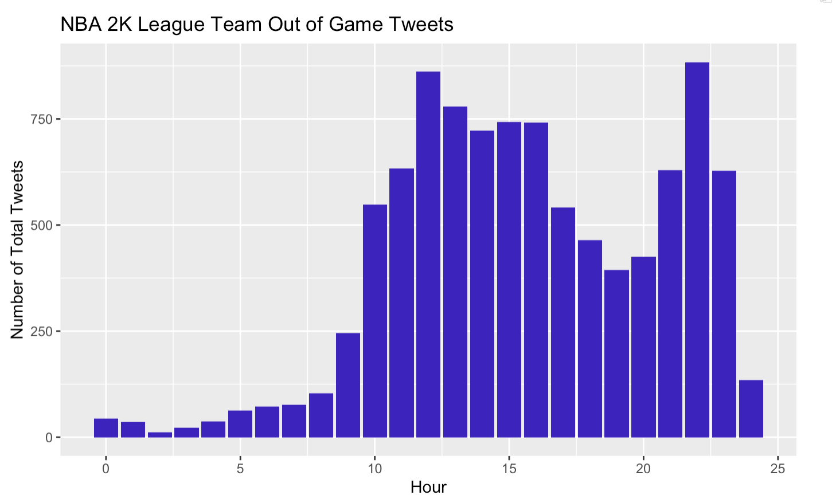
Current Affiliate League Out-of-Game Tweet Times: Similar but unique distributions
G League Max: 11am
WNBA Max: 10am
2K Max: 10pm
Excluded data from midnight-7am (except G League) due to lack of activity (<100 tweets/hour for all 10 months combined)

Slide 5
Methodologies
WNBA
NBA
G League
2K
Model Type: Polynomial Regression
Variables:
Quote Tweets
Retweets
Followers
Hours of Tweets
Data:
Excluded 1AM-7AM
Out of game tweets only
Excluded two weeks of tweets during Tokyo Olympics
Model Type: Negative Binomial Regression
Variables:
Retweets
Hours of Tweets
Media Type
Data:
Excluded 1AM-7AM
No game time filtering
Model Type: Negative Binomial Regression
Variables:
Retweets
Time Groups of Tweets
Media Type
Data:
No timing exclusions
Model Type: Polynomial Regression
Variables:
Quote Tweets
Retweets
Followers
Hours of Tweets
Data:
Excluded 1AM-7AM
Out of game tweets only

Slide 6
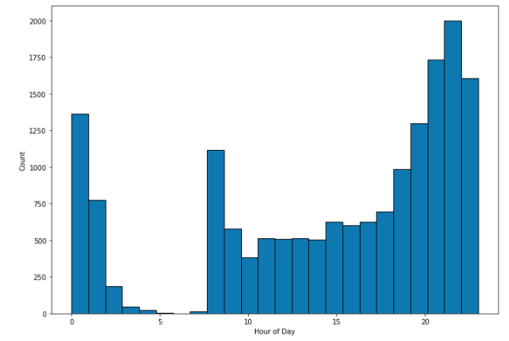
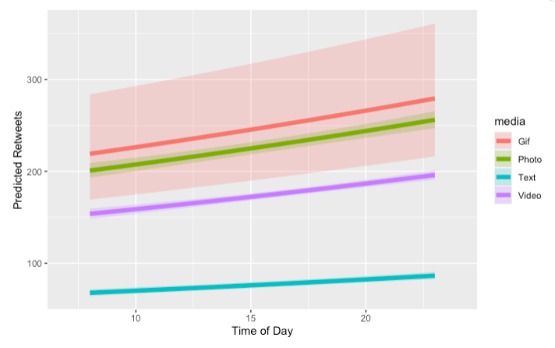
NBA Results
Takeaways
Better to post all media types after 10pm EST to get the highest retweets.
We expect a tweet posted with a GIF included to increase the mean number of retweets by 2.89x, a Photo included by 3.02x and a Video by 2.35x
Most overall engagement associated with large headlines (e.g. NBA75, Kobe Bryant, Bucks winning Title)

Slide 7
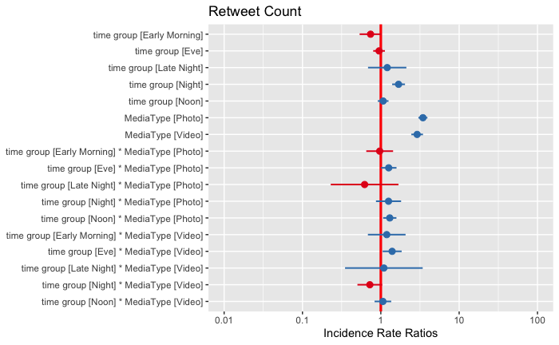
G-League Results
Takeaways
Tweets posted during night compared to morning have an increase in mean number of retweets by 1.7x
Better to post photos during noon/afternoon (12-4PM)
Better to post videos during eve (8-12AM)
Other Recs:
Create G league Ignite Twitter!
1.
2.
3.

Slide 8
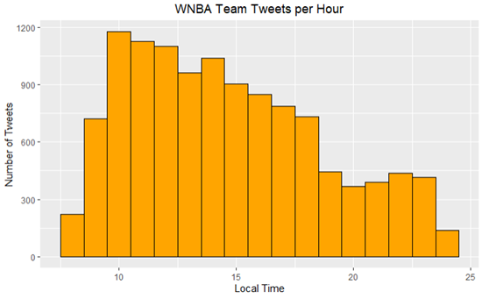
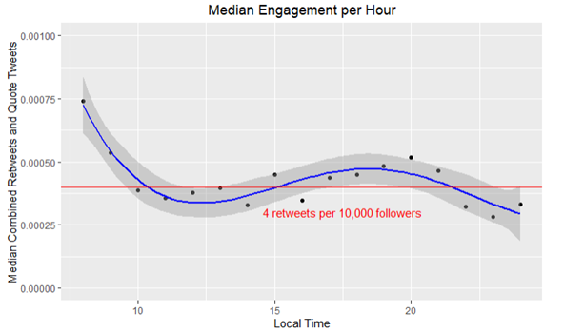
WNBA Results
Takeaways:
Teams currently tweet the most at 10am and 11am
Tweet during 8am and 9am for the highest engagement
Tweet between 3pm and 9pm for above average engagement
Potential Drawbacks
Overfitting with polynomial model
Cannot account for media type in current model

Slide 9
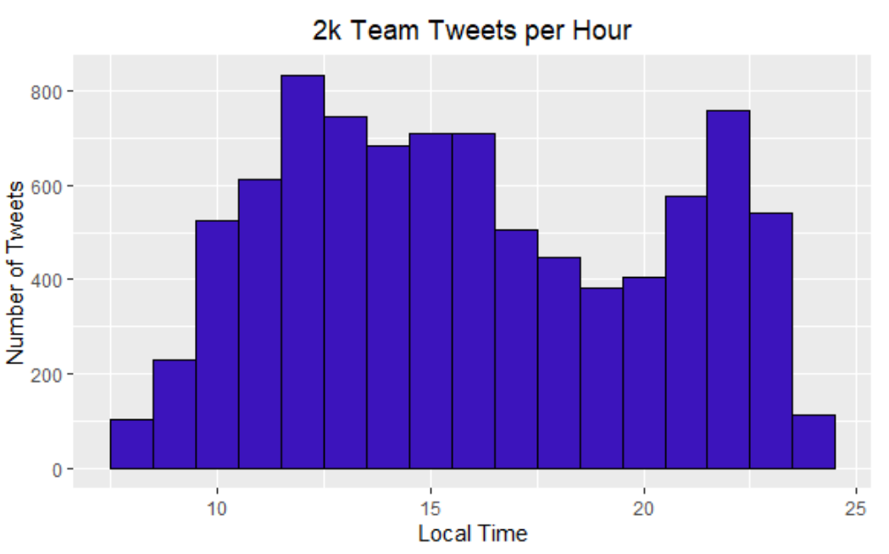
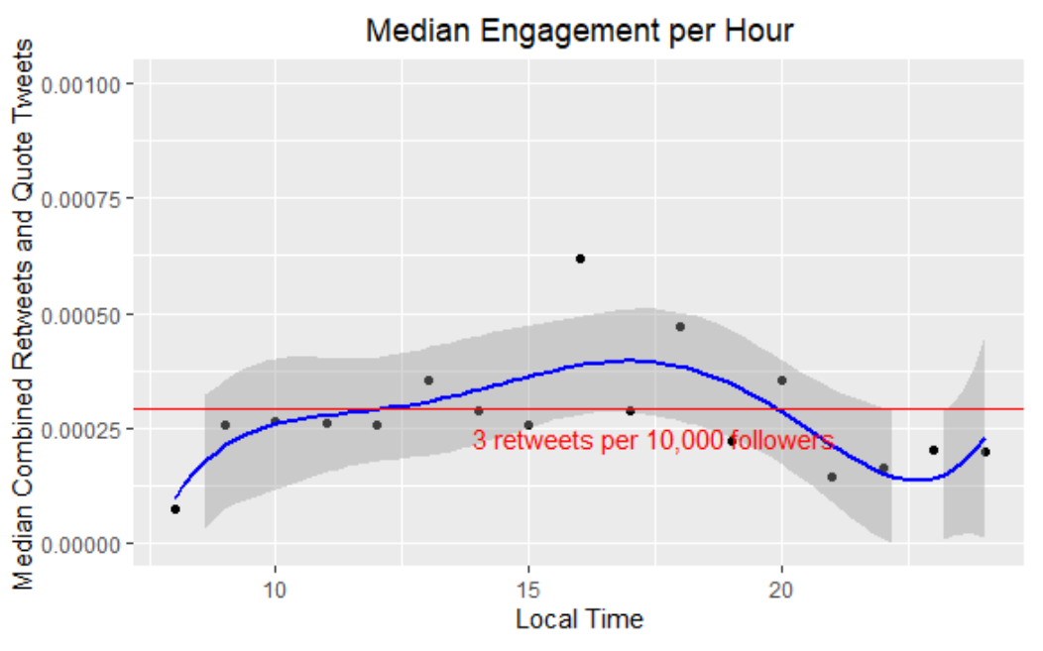
2K Results
Takeaways
Teams are currently tweeting the most at 12pm and 10pm
Tweet during 5pm-6pm for the highest engagement
Tweet between 12pm and 10pm for above average engagement
Potential Drawbacks
Overfitting with polynomial model
Cannot account for media type in current model

Slide 10




Recommendations Overview
Post Media after 10pm
Photos have greatest engagement increase (3.02x)
Use large headlines
Post at night for 1.7x more retweets
Post photos between 12-4pm
Post videos between 8pm-12am
Create G-League Ignite Twitter
Post during 8-9am for the highest engagement
Post during 3-9pm for above average engagement
Post between 5-6pm for the highest engagement
Post between 12-10pm for above average engagement
NBA
G-League
WNBA
2K

Slide 11




Next Steps
Develop an interpretable engagement index for social medias
Explore more predictive models (ex. Random Forests)
Dive deeper into media types impact on engagement rather than time
Break league data down further into team-by-team data

Slide 12
Results Overview
Media: post after 10pm
Photos: greatest engagement increase (3.02x)
Use large headlines
General: Post at night
Photos: 12-4pm
Videos: 8pm-12am
Create G-League Ignite Twitter
Best engagement: 8-9am
Above average engagement: 3-8pm
Best engagement: 5-6pm
Above average engagement: 12-10pm
NBA
G-League
WNBA
2K

Slide 13
Appendix

Slide 14
Methodology: G League
Model
Negative Binomial Regression: interpretable, works well for overdispersed count data (compared to OLS and Poisson)
Dependent Variable
Retweets
Variables of Interest
Time (Hour Groups)
Late Night (12-4AM), Early Morning (4-8AM), Morning (8AM-12PM), Noon (12-4PM), Evening (4-8PM), Eve (8PM-12AM)
Media and Time (Interaction effect)
Control
Followers
Media Type (Video, Photo, Gif, Text)
Month
Day of Week

Slide 15
Methodologies
WNBA/2K
Model Type: Polynomial Regression
Model: (Quote Tweets + Retweets)/Followers ~ Hour
Data: Excluded hours 1 - 7 (1AM-7AM), Team tweets removed from time of game start to 3 hours after, also excluded two weeks of tweets during Tokyo Olympics (non-normal tweet & viewership habits regarding time) for WNBA
NBA
Model Type: Negative Binomial Regression
Model: Retweets ~ Hour + Media Type
Data: Excluded hours 1 - 7 (1AM-7AM), no game time filtering
G League
Model Type: Negative Binomial Regression
Model: Retweets ~ Time Group + Time Group * Media Type + Control Variables (reference Appendix for control and Time Group)
Data: Didn’t exclude that timing
Notes:
Explain timing decisions
Explain any assumptions (engagement index??)
Exclude data from midnight-7am, there were less than 100 tweets per hour for the entire 10 months for each league

Slide 16
Appendix
def time_group(row):
x = row['localized_hour']
if (x > 4) and (x <= 8):
return 'Early Morning'
elif (x > 8) and (x <= 12 ):
return 'Morning'
elif (x > 12) and (x <= 16):
return'Noon'
elif (x > 16) and (x <= 20) :
return 'Eve'
elif (x > 20) and (x <= 24):
return'Night'
elif (x <= 4):
return'Late Night'

Slide 17
